Slide 1
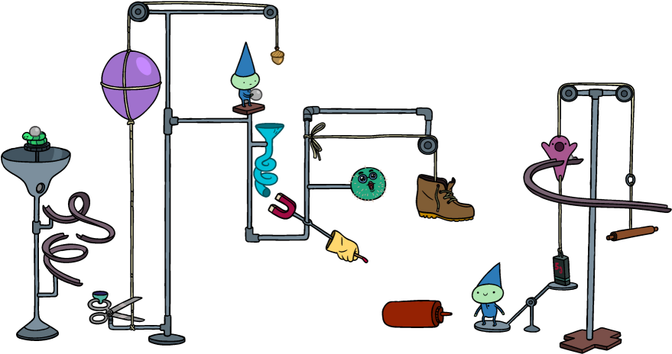
Rube Goldberg Team
Final Proposal Presentation
Summer 2019
Jassem Alhaddad
Ali Alrashidi
Omar Aldhafeeri
Ali Almari
Mohammed Albanaqi
Abdullah Alsayeh

Slide 2
Overview
Project Description
Design Description
Design Requirements
Changes
Bill of Material
Budget

Slide 3
Project Description
Rube Goldberg is a machine that performs a very simple task in a very complex fashion, usually including a chain reaction.
The objective is to create a reliable and resettable machine of Rube Goldberg steps.

Slide 4
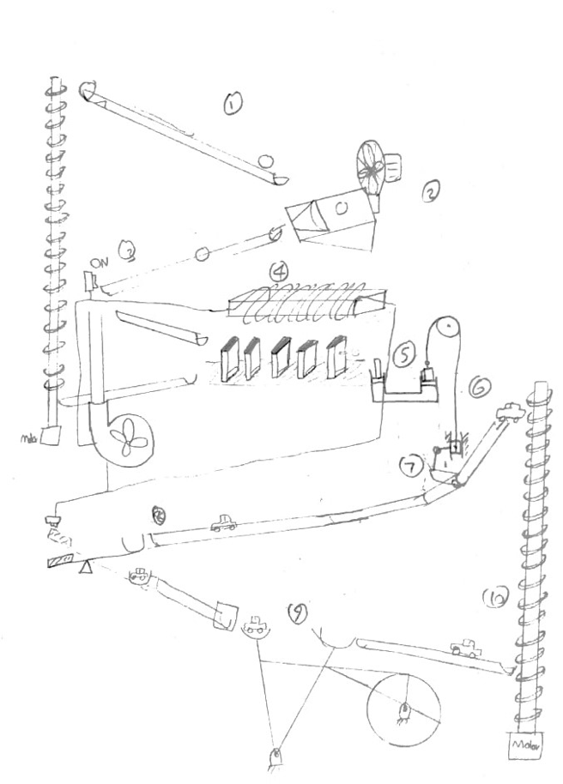
Design Description

Slide 5
Design Requirements
Cost
Safety
Realistic
Size (10 * 10 ft^2)
Resettable
Timing
Animals
Flammable
Noise
Abdullah

Slide 6
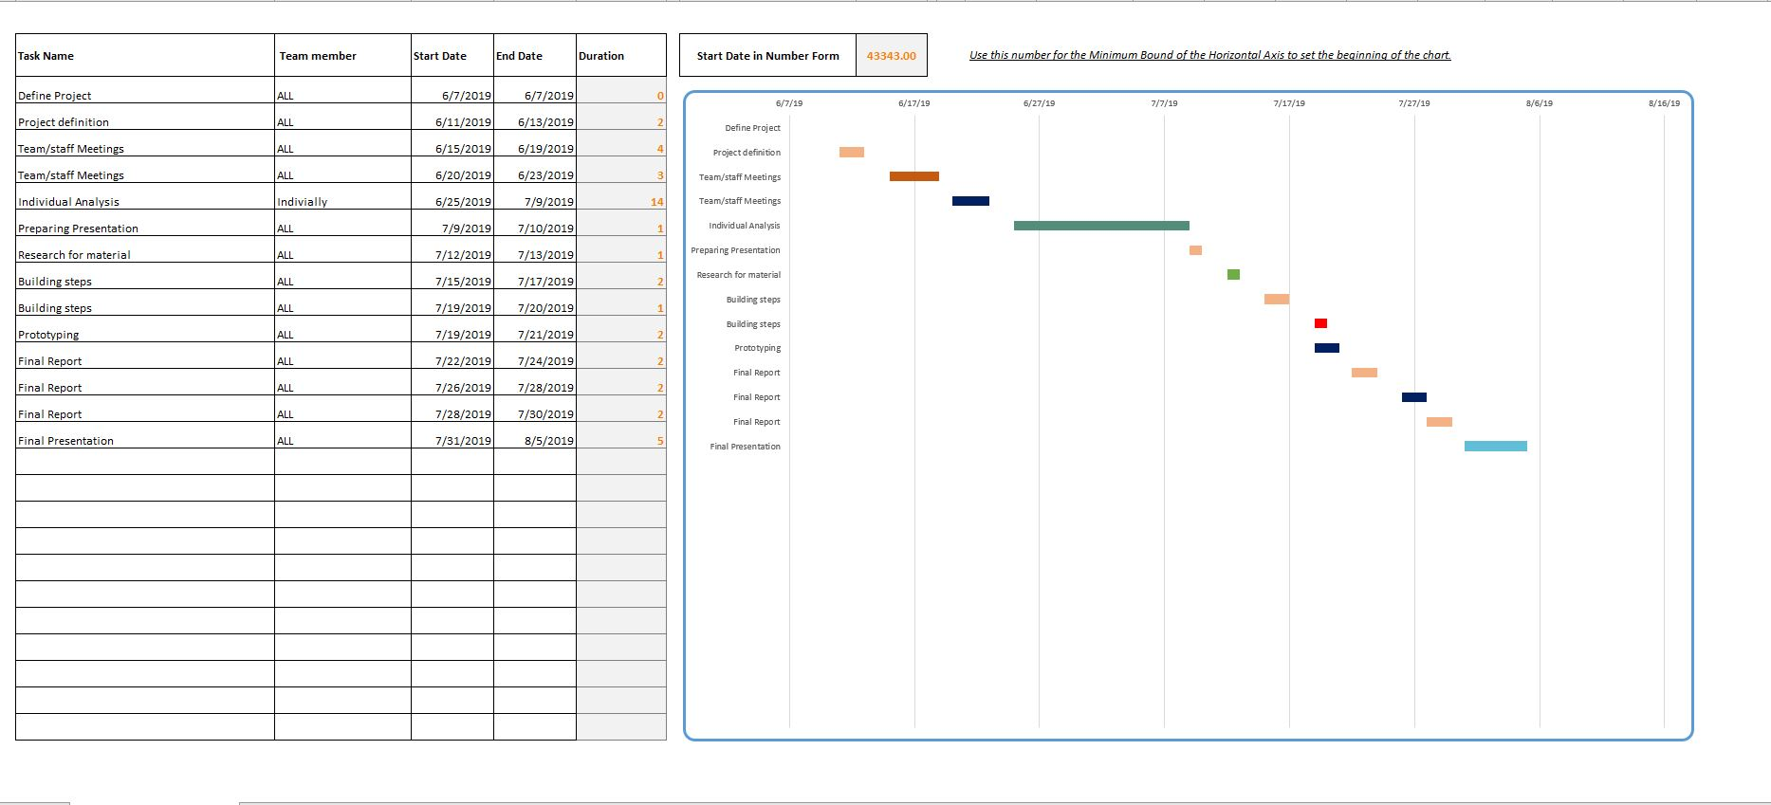
Gantt Chart
Omar Aldhafeeri

Slide 7
Changes
Dominos steps using electromagnet
Pull roll using gravity
Hair Drier
Pascal Law
Lever
Convert Belt

Slide 8
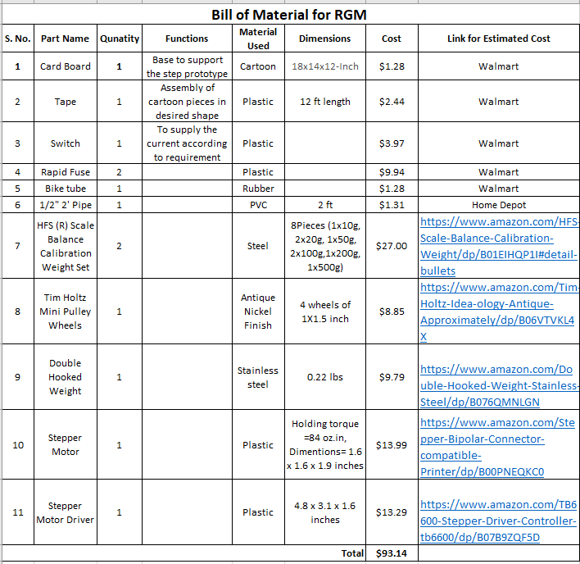
Bill of Material

Slide 9
Budget
Expense Details | Cost
Total Budget | $1500
Anticipated Expenses | $1000
Actual Expenses | $130
Resulting Balance | $1272
We are currently on schedule
Mohammed Albanaqi

Slide 10
Budget
Items | Quantity | Cost | Reference
Wild wire | 2 | $15 | Home depot
White peg board | 1 | $22 | Home depot
Balls | 10 | $6 | Walmart
Fan | 1 | $15 | Walmart
Light switch | 1 | $9 | Walmart
Way paddle switch | 1 | $3 | Walmart
Light control | 1 | $6 | Walmart
Flex funnel | 1 | $6 | Autozone
Softwood board | 1 | $48 | Home Depot
“ Cont’d ”
Total
$130
Mohammed Albanaqi

Slide 11
References
[1]BarD Software s.r.o, “Build - GanttProject Docs,” Ganttproject.biz, 2018. [Online].
https://docs.ganttproject.biz/development/build/
‌
[2]“Rube Goldberg – Home of the Official Rube Goldberg Machine Contests.” Rubegoldberg.Com, 2018, www.rubegoldberg.com/. Accessed 11 July 2019.
[3]Nau.Edu,2019,nau.edu/visual-identity-guide/wp-content/uploads/sites/121/2018/09/NAU_Acronym_Horiz_1Line-281_3514-1024x50.png. Accessed 11 July 2019.
‌

Slide 12
Questions?

